Slide 1
Final Project Presentation
CS-UY 4563
2:00PM Section
04/30/2021
Prof. Linda M. Sellie
Zijie Xiong, Aditya Dheer

Slide 2
Introduction
We used data set form kaggle containing 145,461 records of weather observations all across Australia.
Preprocessing
Seperate the last column as the target variable and drop out the location name and date.
Drop out all wind-direction columns because variation is too large.
Drop out lines with null values as target value.
Replace null value in other columns with mean value of that column.
Separate into training set of 105,590 records and test set of 35,197 records.
Preprocess both sets with “sklearn.preprocessing”

Slide 3
Logistic Regression
Tried 26 different versions
Regularization: L1, L2, none
6 different c-values were tried: [0.01, 0.1, 1, 10, 100, 1000]
Two different threshold values: 0.5 and 0.2 for predicting 1
Only a slight improvement was seen in test accuracy by varying hyperparameters. Highest accuracy achieved was 84.39% (l2, C=0.1).
Models didn’t overfit or underfit since only a small difference was seen in the training and test accuracy which is to be expected.
High number of false negatives were seen when the threshold was set to 0.5 however changing it 0.2 for predicting 1, significantly decreased the best test accuracy to 77.76% (l1, C = 10).
Confusion matrix for both are shown on the next slide.

Slide 4
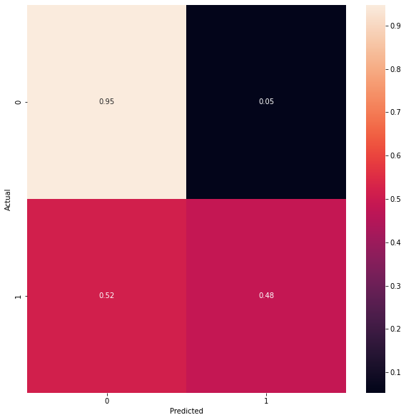
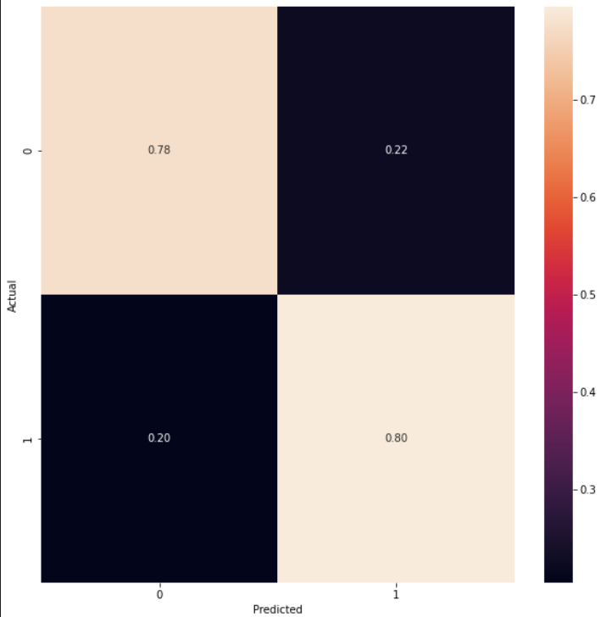
Logistic Regression
Figure: Normalized (per row) confusion matrix for Logistic Regression parameters with the highest test accuracy (Regularization = “l2”, C = 0.01)
Figure: Normalized (per row) confusion matrix for Logistic Regression (lower threshold) parameters with the highest test accuracy (Regularization = “l1”, C = 10)

Slide 5
Support Vector Machine(SVM)
12 different parameters
Linear Polynomial, Radial-basis-function kernels
4 different C-values
105,000 Training/35,000 Test samples
No worries of overfitting or underfitting, but divided performance
Bad performance in correctly predicting rainy days.
Best test accuracy was 85.2061% using RBF kernel, C = 10

Slide 6
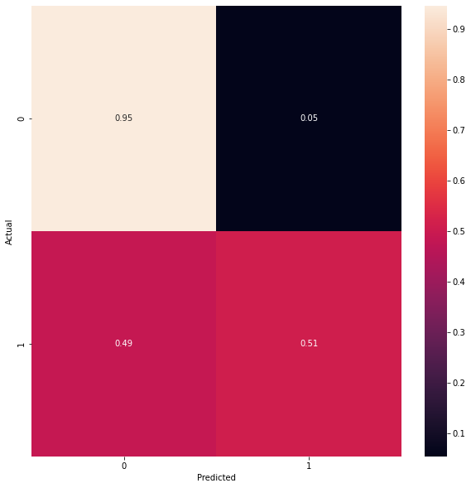
Neural Networks
18 different variations were tried
3 different activation function: ReLU, tanh, sigmoid
Alphas: [0, 0.001, 0.01, 0.1, 1, 10]
Learning rate: 0.01
Max iterations: 2000
Total 10 hidden layers (used sklearn’s implementation)
No Issues overfitting or underfitting
Max test accuracy: 85.28%
Activation: tanh
Alpha: 0.01

Slide 7
Conclusion
All 3 models have a high number of false negatives.
Linear Regression
Include more relevant feature
Improvements for SVM
Using different kernel functions
Include more relevant feature
Neural networks
Include more relevant feature
Increase the size of the training data
Over all the highest accuracy is 85.2874% using neural networks
We prefer logistic regression with lower threshold for a decrease false negative
Accuracy is 77.9612%

Slide 8
Works Cited
Rain in Australia Predict next-day rain in Australia:
https://www.kaggle.com/datasets/jsphyg/weather-dataset-rattle-package
Confusion Matrix:
https://stackoverflow.com/questions/20927368/how-to-normalize-a-confusion-matrix
Logistic Regression sklearn:
https://scikit-learn.org/stable/modules/generated/sklearn.linear_model.LogisticRegression.html
MLP classifier sklearn:
https://scikit-learn.org/stable/modules/generated/sklearn.neural_network.MLPClassifier.html
Replace missing observations with mean:
https://thispointer.com/pandas-replace-nan-with-mean-or-average-in-dataframe-using-fillna/

